Slide 1

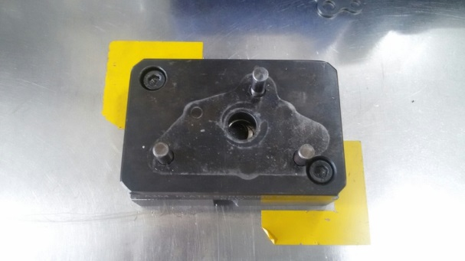
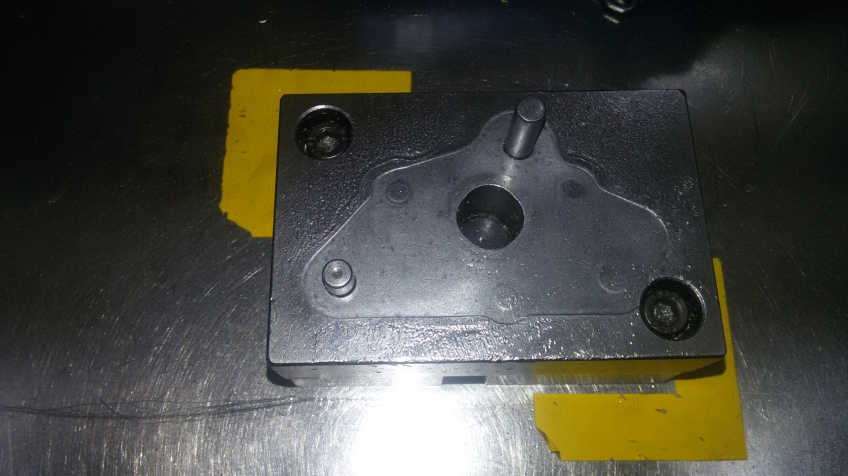
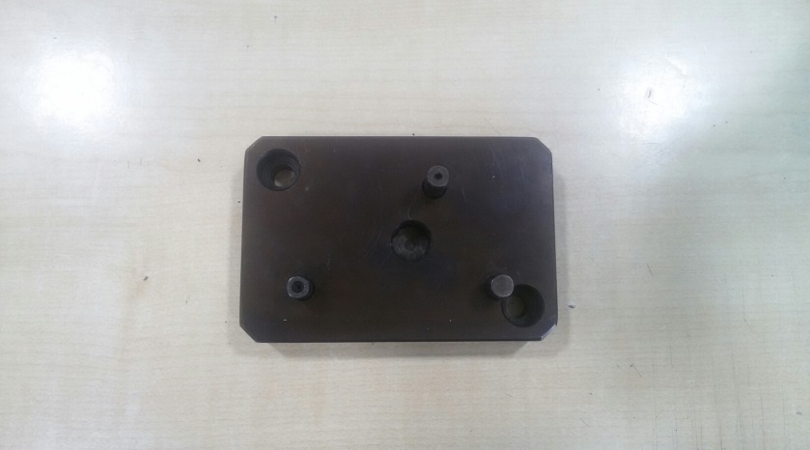
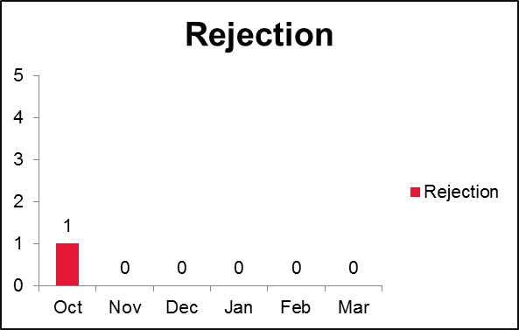
P15
TPM CIRCLE NO :- 01
ACTIVITY
KK
QM
PM
JH
SHE
OT
DM
E&T
KAIZEN IDEA SHEET
TPM CIRCLE NAME: Oil Pump
LOSS NO. / STEP
DEPT :-Assembly
RESULT AREA
P
Q
A
C
D
S
M
B
CELL :-Oil pump
CELL NAME:-A354 /A314
MACHINE / STAGE:A354/314 plate fittment
OPERATION :-Plate Assembly
KAIZEN THEME : To avoid customer complaint of wrong shaft assembly.
IDEA :-.
COUNTERMEASURE:-Screw tightening not possible as plate rest on body and torque gun does not start
BENCHMARK
TARGET
Problem present status: Wrong shaft assembly possible as shaft difference not detected by assembly fixture
KAIZEN START
KAIZEN FINISH
TEAM MEMBERS : Rohini Pokharkar,
nitin sutar, Amit dhage ,Bhavesh pednekar
BENEFITS :-No customer complaint
Improve quality
Before
After
KAIZEN SUSTENANCE
WHY - WHY ANALYSIS :-
Why1 : Wrong shaft assembly possible at plate fitment
Why2:- Current process allow Wrong shaft assembly
Why3 :- No provision to arrest to shaft height different
RESULT : Remove Chances of passing mix up
WHAT TO DO:
HOW TO DO: frequently part wise change fixture
FREQUENCY –daily
SCOPE & PLAN FOR HORIZONTAL DEPLOYMENT
ROOT CAUSE : No provision to arrest to shaft height different.
REGISTRATION NO. & DATE : 10 .11.16
REGISTERED BY :-Rohini
MANAGER’S SIGN :-J . Sathe

